Slide 1

https://www.uni-goettingen.de/en/48115.html
UNPLAB-QuGen_Ch-7[Stat Mod II]
The statistical model to decompose (and re-compose) the genetic value. It leads to the additive variance; you need to know the Metric Model for this chapter.
1

Slide 2
Sequential Number: #41
UNPLAB-QuGen_Ch-7[Stat Mod II]
Unless I explicitly state otherwise, images and cartoons are created using ChatGPT.
You may use this material free of charge under the terms of the CC BY license. This requires that you provide appropriate attribution to the author:
W. Link, University of Goettingen, Germany.
In a few cases, individual images, photographs, or similar material may be subject to a more restrictive Creative Commons license. Where this applies, it is explicitly indicated, and you must comply with the stated license terms for those items.
Please check the license information carefully before reuse. Responsibility for complying with the applicable license terms rests entirely with you.
2

Slide 3
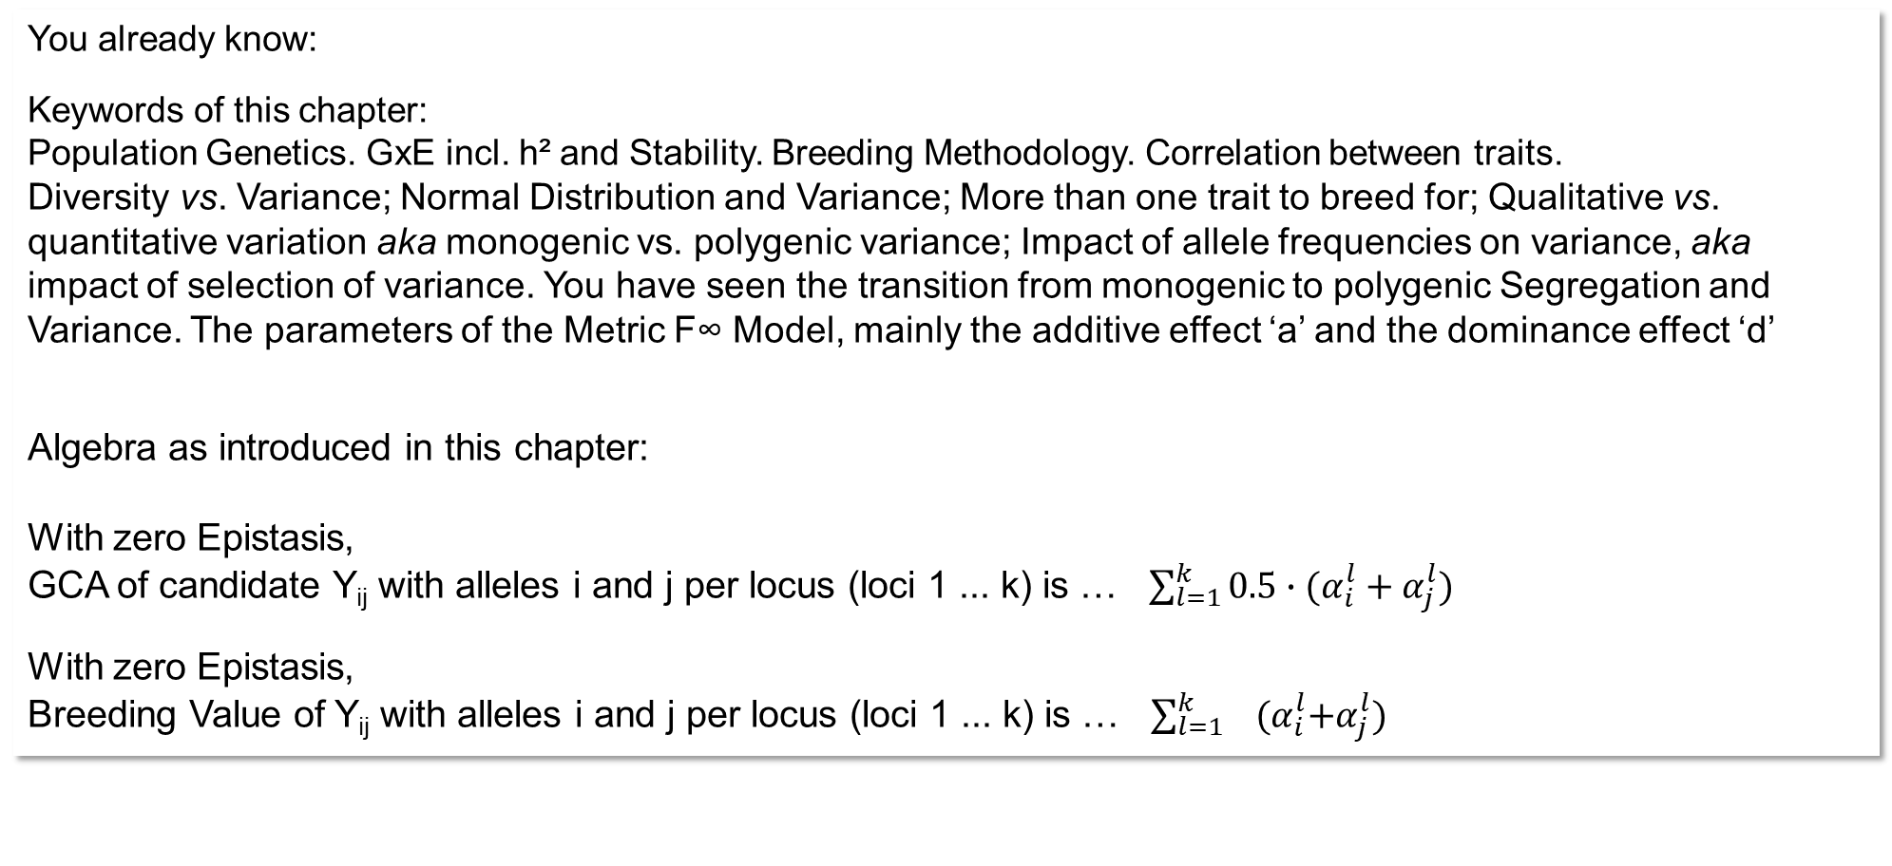
You already know:
Keywords of this chapter:
Population Genetics. GxE incl. h² and Stability. Breeding Methodology. Correlation between traits.
Diversity vs. Variance; Normal Distribution and Variance; More than one trait to breed for; Qualitative vs. quantitative variation aka monogenic vs. polygenic variance; Impact of allele frequencies on variance, aka impact of selection of variance. You have seen the transition from monogenic to polygenic Segregation and Variance. The parameters of the Metric F∞ Model, mainly the additive effect ‘a’ and the dominance effect ‘d’
Algebra as introduced in this chapter:
With zero Epistasis,
GCA of candidate Y_{ij} with alleles i and j per locus (loci 1 ... k) is … $\sum_{l=1}^{k}{{0.5∙(α}_{i}^{l}+α_{j}^{l}})$
With zero Epistasis,
Breeding Value of Y_{ij} with alleles i and j per locus (loci 1 ... k) is … $\sum_{l=1}^{k}{{ (α}_{i}^{l}+α_{j}^{l}})$
3

Slide 4
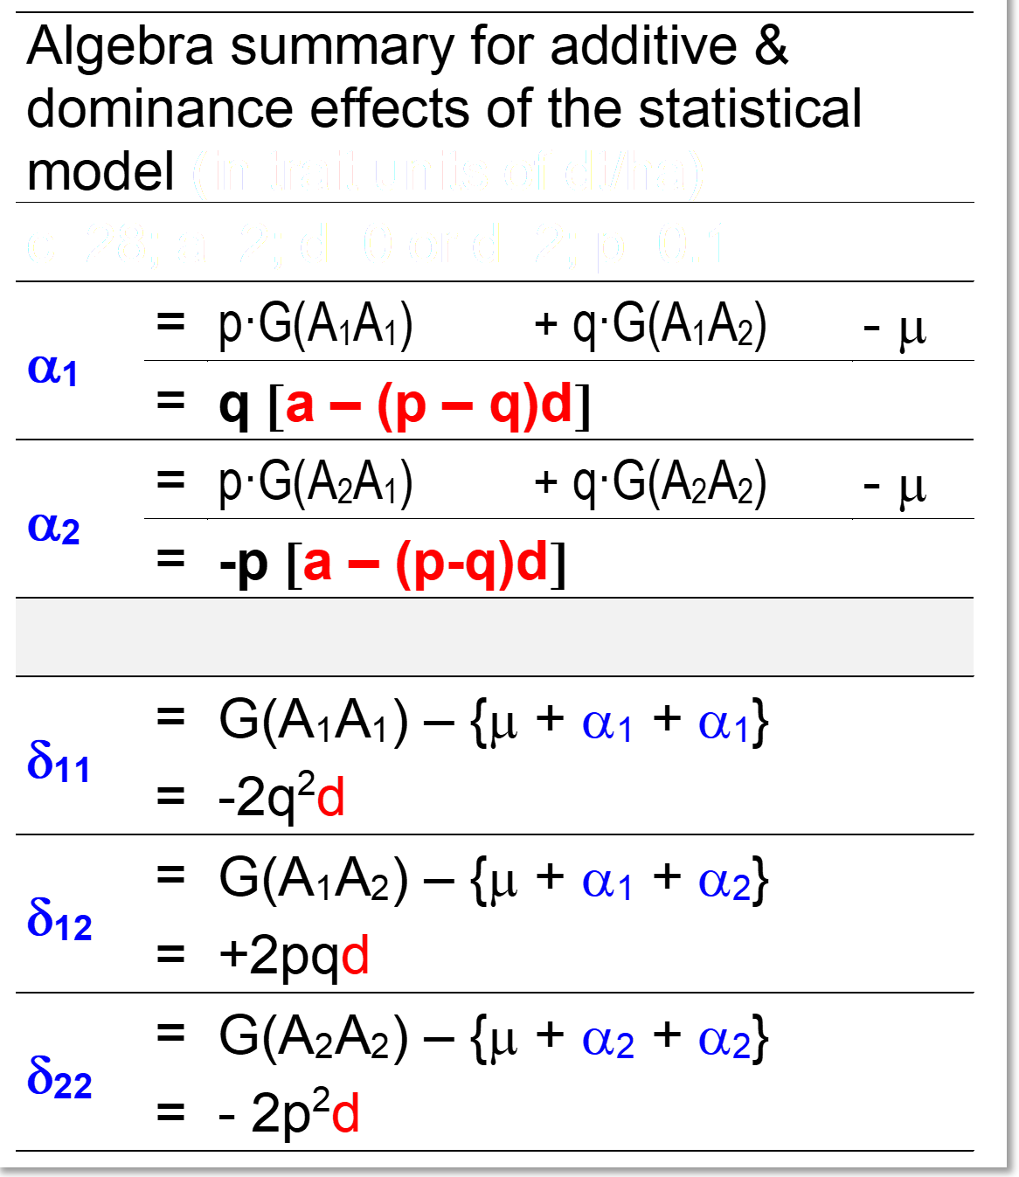


Reminder. Breeding Value A per locus is α₁+ α₁ or α₁+ α₂ or α₂+ α₂ depending on the actual genotype. The dominance deviation D is, accordingly, δ₁₁ or δ₁₂ or δ₂₂.
© WL
4

Slide 5
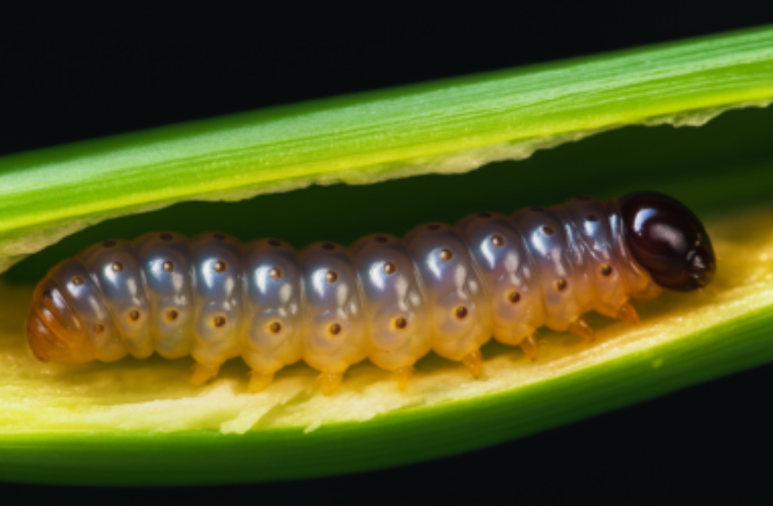
Exercise
Schön, C.C. et al., 1993. Heredity 70, 648-659
QTL1 has alleles A1 and A2; etc.
The best-possible genotype, i.e., with the shortest tunnel length, is:
A1A1/B1B1/C1C1/D1D1/…
E1E2/F1F1/G1G2. At two loci, the size of d is stronger than of a; and it is in the favourable directions, hence, heterozygosity is optimum (Allele X1 being the good one throughout).
20.8
That most-resistant genotype has as tunnel length: c -a₁-a₂-a₃-a₄+d₄-a₅+d₆-a₇ = 28.80cm (‘short is good’).
The cited paper states: 38% of the phenotypic variance could be explained by the joint impact of the seven detected putative QTL; and h²=0.63. Correspondingly, these QTL explain R²=0.38/0.63=0.603 hence 60.3% of the genetic variance. Hence, there must be undetected QTL, responsible for the remaining 39.7%. We here, for our exercise purpose, behave as if 100% of the genetic variance was explained by those seven loci (seven QTL).
5

Slide 6
Be aware that here, the agronomically favourable effect is to reduce tunnel length, hence it is the ‘reducing’ allele which is favourable.
We define the ‚good‘ allele at QTL A to be the allele A1
We define the ‚good‘ allele at QTL B to be the allele B1
We … et cetera , until at QTL G to be the allele G1
The metric additive effect a does not show a negative sign, since it is ‚just‘ half the difference between the two homozygotes. In the metric model, unlike the statistical model, there is not a specific first additive effect for allele A1 and a specific second additive effect for allele A2 (well, in this simple-minded 2-allele case).
Nevertheless, given this selection direction towards shorten tunnel length, the average additive effects of the ‚favourable‘ alleles are negative.
6

Slide 7
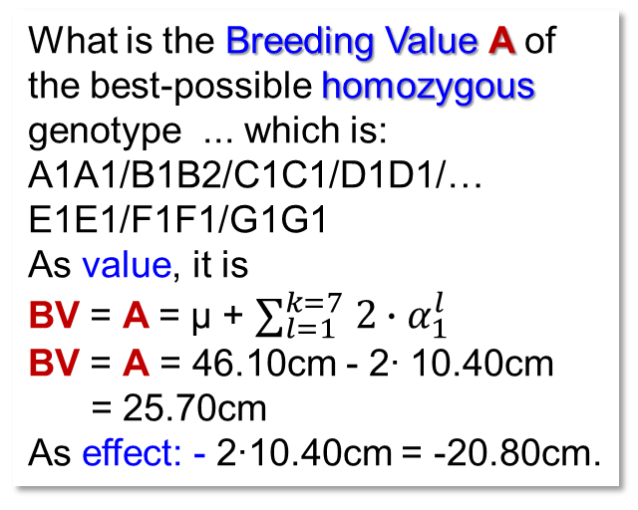
Exercise, p(A1)=50%
Schön, C.C. et al., 1993. Heredity 70, 648-659
What is the Breeding Value A of the best-possible homozygous genotype ... which is:
A1A1/B1B2/C1C1/D1D1/…
E1E1/F1F1/G1G1
As value, it is
BV = A = µ + $∑_{l=1}^{k=7} 2∙α_{1}^{l}$
BV = A = 46.10cm - 2∙ 10.40cm
= 25.70cm
As effect: - 2∙10.40cm = -20.80cm.
20.8
The Breeding Value A of the best inbred line is quite large (absolute value: 51.26cm). Here! ... beneficial alleles are rare (10% at each locus) and anyway they are more or less dominant – hence, the seven α₁ are quite large.
The naïve sum of R² of the 7 QTL was R²_{naïve} =50.8%. The “% phenotypic variance ‘explained’ ”, R², as resulting from fitting all 7 QTLs simultaneously, R²_{simult.} =38.0%. Ponder a bit. The estimate of a QTL‘s metric additive effect comes from phenotype-comparing individuals being A1A1 at that locus with those being A2A2. Half that difference estimates a of that locus. Having marker-analysed 300 F2-plants, how many may be A1A1, how many A2A2?
7

Slide 8
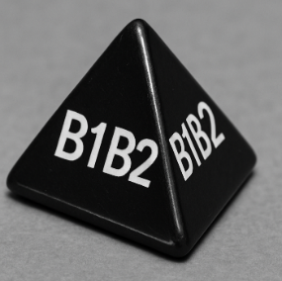
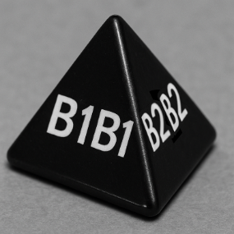
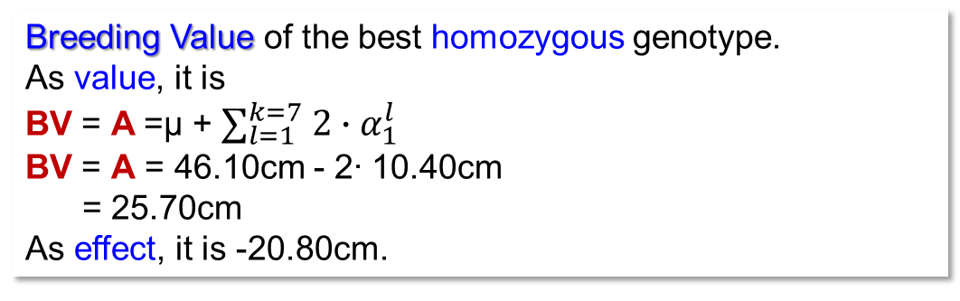
Exercise, p(A1)=50%
Schön, C.C. et al., 1993. Heredity 70, 648-659
N=300 F2-individuals; 300/4=75
Breeding Value of the best homozygous genotype.
As value, it is
BV = A =µ + $∑_{l=1}^{k=7} 2∙α_{1}^{l}$
BV = A = 46.10cm - 2∙ 10.40cm
= 25.70cm
As effect, it is -20.80cm.
How many in F2 may be A1A1, how many A2A2? Following the expected 1:2:1 segregation, we assume about 75 F2 plants ‘A1A1’ and 75 to be ‘A2A2’. Contemplate the genetic background of these 75 A1A1 and those 75 A2A2!
Well. For all loci unlinked-to-QTL1, the average background of the two groups should be the same. 25% of the 75 A1A1 individuals should be B1B1, 25% should be B2B2, 50% B1B2 (same for the A2A2) ... thus QTL2 should not impair the A1A1◄► A2A2 difference (not impair our estimate of that a-effect). But: The probability that a four-sided dice (B1B1 or B2B2 or twice B1B2) thrown 75 times yields e.g. B1B1 18 or 19 times (as expected) is only about 21%. So, in the majority of cases, we expect that the A1A1 genotypes differ by chance from the A2A2 genotypes for their QTL2 composition. If the A1A1 group contains more B1B1 than the A2A2, what then? The difference between A1A1◄► A2A2 (our estimate of a) would be increased (by the secret, ‘exaggerating help’ from the QLT2). Same at further loci (QTL). The estimated additive effect a is expectedly the more biased the smaller the sample of F2-plants is (even without LD and/or epistasis between QLT1 and QTL2). LD and epistasis are indeed sources of further bias in the estimates of QTL effects such as A1A1◄► A2A2 .
These may be reasons that a naïve summation of effects or of contributions to variance across loci is ... naïve ;-)
even without LD and/or epistasis between QLT1 and QTL2
8

Slide 9
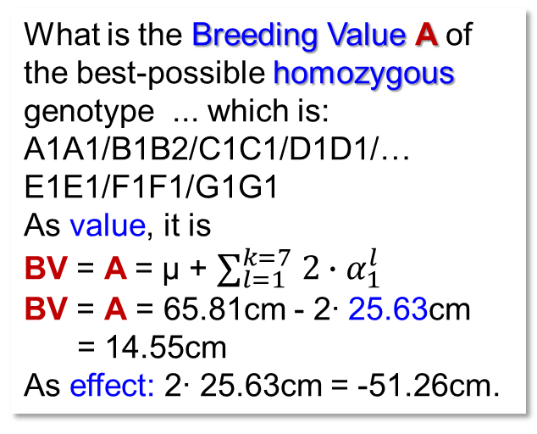
Exercise, p(A1)=10% now!
p(A1)=10% now
Schön, C.C. et al., 1993. Heredity 70, 648-659
What is the Breeding Value A of the best-possible homozygous genotype ... which is:
A1A1/B1B2/C1C1/D1D1/…
E1E1/F1F1/G1G1
As value, it is
BV = A = µ + $∑_{l=1}^{k=7} 2∙α_{1}^{l}$
BV = A = 65.81cm - 2∙ 25.63cm
= 14.55cm
As effect: 2∙ 25.63cm = -51.26cm.
The Breeding Value A of the best inbred line is quite large now (absolute value: 51.26cm). Here! ... beneficial alleles are rare (10% at each locus) and anyway they are more or less dominant – hence, the seven α₁ are quite large.
9

Slide 10
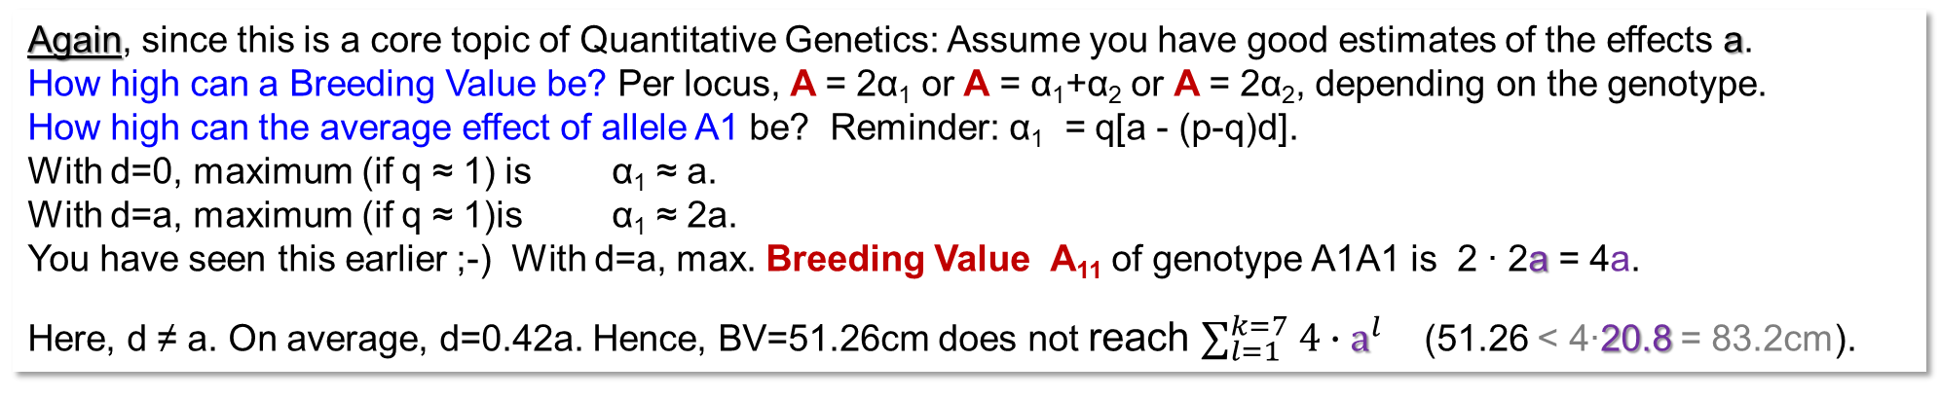
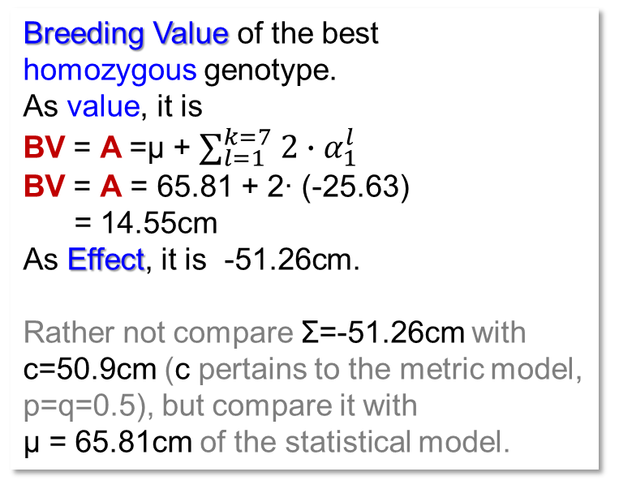
Exercise, p(A1)=10% now!
Schön, C.C. et al., 1993. Heredity 70, 648-659
Breeding Value of the best
homozygous genotype.
As value, it is
BV = A =µ + $∑_{l=1}^{k=7} 2∙α_{1}^{l}$
BV = A = 65.81 + 2∙ (-25.63)
= 14.55cm
As Effect, it is -51.26cm.
Rather not compare Σ=-51.26cm with c=50.9cm (c pertains to the metric model, p=q=0.5), but compare it with
µ = 65.81cm of the statistical model.
Again, since this is a core topic of Quantitative Genetics: Assume you have good estimates of the effects a.
How high can a Breeding Value be? Per locus, A = 2α₁ or A = α₁+α₂ or A = 2α₂, depending on the genotype.
How high can the average effect of allele A1 be? Reminder: α₁ = q[a - (p-q)d].
With d=0, maximum (if q ≈ 1) is α₁ ≈ a.
With d=a, maximum (if q ≈ 1)is α₁ ≈ 2a.
You have seen this earlier ;-) With d=a, max. Breeding Value A₁₁ of genotype A1A1 is 2 ∙ 2a = 4a.
Here, d ≠ a. On average, d=0.42a. Hence, BV=51.26cm does not reach $∑_{l=1}^{k=7} 4∙a^{l}$ (51.26 < 4∙20.8 = 83.2cm).
Go back to page 5 and see: Σof the seven metric a effects is 20.8cm.
10

Slide 11
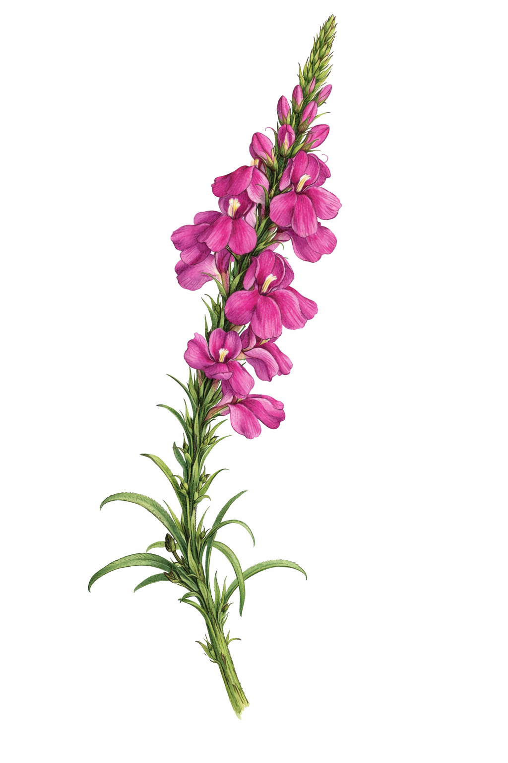
We leave the corn borer. Back to the one-locus (invented) example on Striga resistance (a=2; d=0 or d=2). Enjoy the graphical display of the Quantitative-Genetics Algebra.
Effect α₂ of recessive allele A2 is ~zero if q(A2)≈0. If anyway nearly ‘all’ are A1A1, then any such rare A2 would occur only as A1A2 with no phenotypic effect). Effect α₂ is again zero at q(A2)=1: If anyway all are A2A2, then A2 causes no disadvantage. Yet, at q(A2)=p(A1)=0.5, gametes carrying ‘A2’ allele inherit a marked disadvantage: The popula-tion µ is higher than offspring of ‘A2’-gametes. In the population, only q²=25% are A2A2, thus µ=29; but offspring of gamete ‘A2’ is [A1A2] and [A2A2] with 1:1, their mean is 28. Hence, at q(A2)=0.5 our α₂ = -1 (and: d=0 is boring).
Striga hermontica
4
α
4
α
1
1
α
α
3
2
3
2
a=d=2
a=2
2
2
d=0
Average effect of allele
Average effect of allele
1
1
α =α₁-α₂
α =α₁-α₂ = a
0
0
Striga hermon-tica, our parasi-tic weed here, as example.
-1
-1
-2
-2
0.0
0.1
0.2
0.3
0.4
0.5
0.6
0.7
0.8
0.9
1.0
0.0
0.1
0.2
0.3
0.4
0.5
0.6
0.7
0.8
0.9
1.0
Frequency p(A1)
Frequency p(A1)
11

Slide 12
Enjoy the visualization of the Algebra. Is it ‘Value’* or is it ‘Effect’?
See again the non-linear increase of the population mean µ, faint-dashed-grey line, as the dominant, favourable allele gets higher in frequency.
With p=q=0.5, these are the BVs (no as deviations from the population mean µ):
BV of A1A1 = 31-29 = 2
BV of A1A2 = 29-29 = 0
BV of A2A2 = 27-29 = -2
Breeding Value of [A2A2]
34
Breeding Value of [A1A2]
Breeding Value of [A1A1]
Population mean µ
Genotypic value of [A2A2]
32
Gen.V. of [A1A1];[A1A2]
31
Dominance
deviation δ₁₁ of [A1A1]
Genotypic / Breeding ‘Value’ (or ‘Effect’)
30
δ₁₂ of [A1A2]
29
28
Dominance
27
deviaton of [A2A2]
26
0.0
0.1
0.2
0.3
0.4
0.5
0.6
0.7
0.8
0.9
1.0
Frequency p(A1)
12
*sensu stricto; usually, effect = value - µ

Slide 13
Enjoy the visualization of the Algebra. Is it ‘Value’ or is it ‘Effect’?
See again the non-linear increase of the population mean µ, grey line, as the dominant, favourable allele gets higher in frequency.
The Breeding Values‘ response on increase of p(A) corresponds to that of the statistical additive effects. At p(A1)≈0, A1A1 individuals have breeding value BV=µ+2(a+d)=34, much larger than µ=26 and larger than its genotypic value (c+a=30). The Breeding Value of A1A2 deviates (δ₁₂) most from its genotypic value at p=q=0.5.
When p(A1) is very small, A1A1 is extremely rare, and the BVs are judged based on the large difference between the two types that do exist (A2A2 and A1A2): A1A2 is 4 units “better” than A2A2 (30-26=4). In our naive linear world, this means that A1A1 is expec-ted to be another 4 units better than A1A2 – ... which is of course not true, hence, surprise, surprise ... dominance deviation δ₁₁ .
Breeding Value of [A2A2]
34
Breeding Value of [A1A2]
Breeding Value of [A1A1]
Population mean µ
Genotypic value of [A2A2]
32
Gen.V. of [A1A1];[A1A2]
Dominance
deviation δ₁₁ of [A1A1]
Genotypic / Breeding ‘Value’ / ‘Effect’
30
δ₁₂ of [A1A2]
BV of of [A1A1]
28
BV of of
[A2A2]
Dominance
deviaton of [A2A2]
26
0.0
0.1
0.2
0.3
0.4
0.5
0.6
0.7
0.8
0.9
1.0
13
Frequency p(A1)

Slide 14
With zero dominance, Breeding Values and Genotypic Values are identical.
In Line Breeding (pure lines as Reference Population and candidates are
homozygous), Breeding Values and Genotypic Values are identical (just as with
d=0 in case of HWE). At p=q=0.5, the Breeding Value (as effect) is the same, whether
d=0 or d>0. Algebra has it: ... [a-(p-q)d] ;-) we indeed have p=q in bi-parental crosses.
Take p=q=0.5;
d=a=2 ►BV=31-29 =2
d=0;a=2 ► BV=30-28 =2
a=2, d=2, c=28
a=2, d=0, c=28
Breeding Value of [A2A2]
Breeding or Genotypic Value of [A2A2]
34
Breeding Value of [A1A2]
34
Breeding resp. Genotypic Value of [A1A2]
Breeding Value of [A1A1]
Breeding resp. Genotypic Value of [A1A1]
Population mean µ
Population mean µ
Genotypic value of [A2A2]
32
Gen.V. of [A1A1];[A1A2]
32
Dominance
deviation of [A1A1]
Value in the sense of including µ
Value; including µ. Otherwise ‘just’ substract µ
30
δ₁₂ of [A1A2]
30
Quantitative Genetics in bi-parental settings with p=q, especially in self-fertilers, is ~ ‚easy‘ ;-) compared to out-crossers (including animals)
28
28
Dominance
deviation of [A2A2]
26
26
0.0
0.1
0.2
0.3
0.4
0.5
0.6
0.7
0.8
0.9
1.0
0.0
0.1
0.2
0.3
0.4
0.5
0.6
0.7
0.8
0.9
1.0
Frequency p(A1)
Frequency p(A1)
14

Slide 15
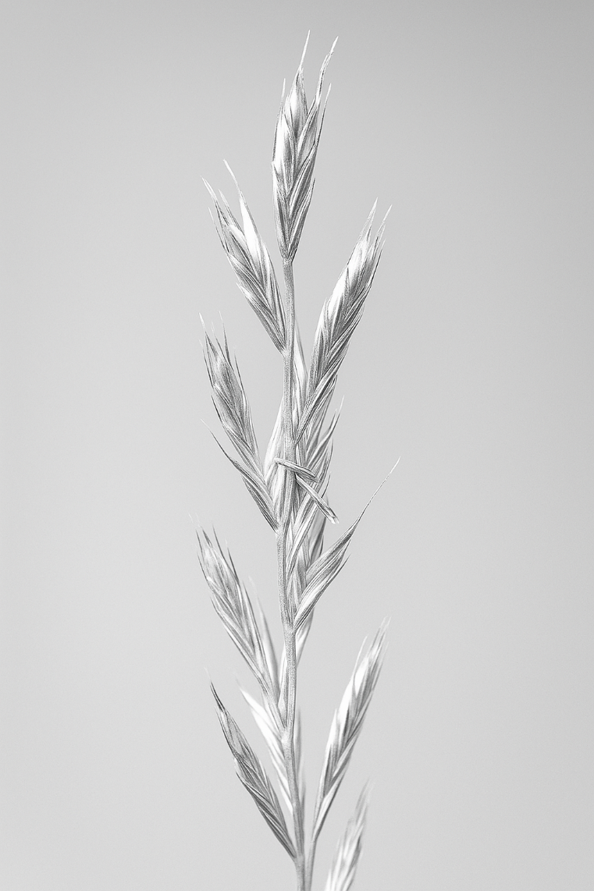
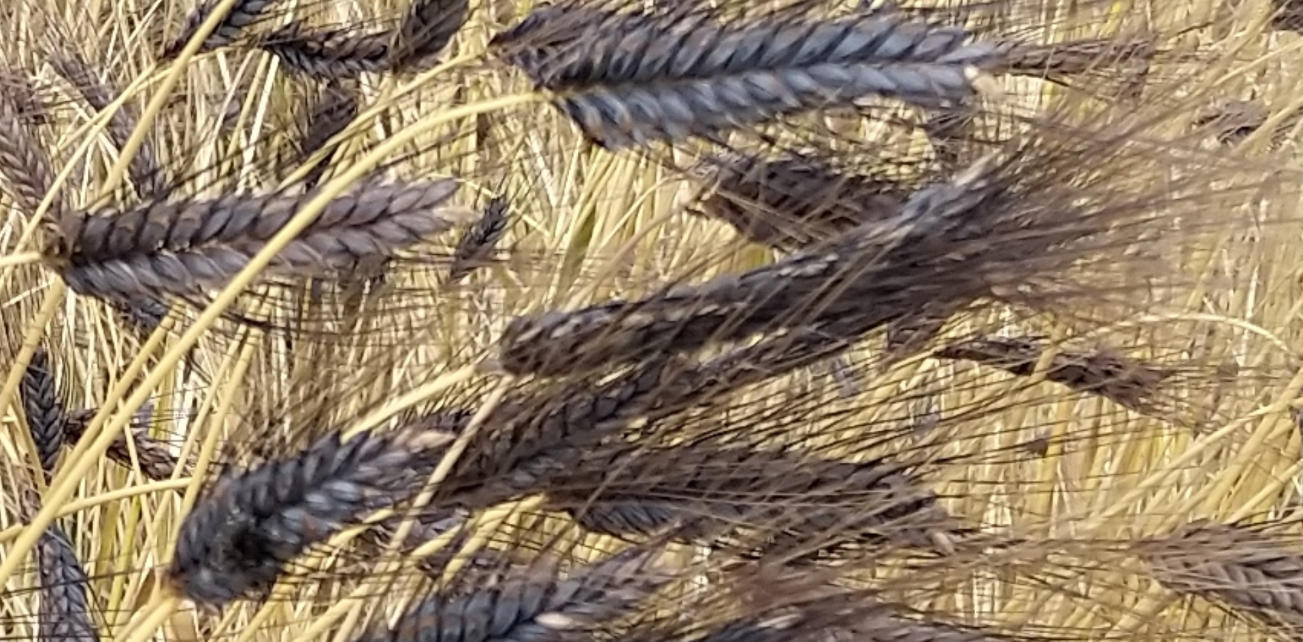
Now, having finally and after much effort arrived at the shores of Breeding Value and the like, we take a deep breathe and turn our minds to these terms:
General Combining Ability; Specific Combining Ability; Diallel and Factorial Cross.
I want to steer towards a comparison between
General Combining Ability (a parameter from Hybrid Breeding)
and
Breeding Value (a parameter from Quantitative Genetics).
Emmer (Triticum di-coccon, cv. ‚Ramses‘
© W. Link
Lolium multiflorum, ear.
15

Slide 16
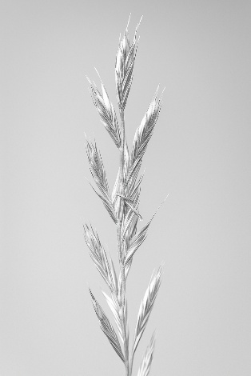
Now, having finally and after much effort arrived at the shores of Breeding Value and the like, we take a deep breathe and turn our minds to these terms:
General Combining Ability; Specific Combining Ability; Diallel and Factorial Cross.
They are important and well-understood by those who breed outcrossers
(crops such as Zea mays, Lolium multiflorum, Secale cereale, Trifolium
pratense, Helianthus annuus, Beta vulgaris, Brassica rapa, … just some
cross-fertilizing row crops; you know them ;-) .
These terms are less-well understood by those who breed crops such
as Solanum tuberosum, Saccharum officinarum, Musa sp., Prunus
avium, Citrus sp., Vitis vinifera, Cicer arietinum, Lens culinaris,
Tr. dicoccon, Eragrostis teff and so on. You got the point, don’t you.
Although animals are outcrossers, animal breeders do not deal so much
with ‘Diallel’ and ‘Factorial’; what may be the reason for this?
16

Slide 17
Random Mating: Each individual has same probability to mate with each. A Diallel Cross is a brute-force imitation of this. Each one is indeed mated with each one.
Take the Diallel Crossing scheme as brut-force imitation of Random Mating.
Accept the good intention for the good deed: Imagine it was not a 10 x 10 Diallel but ... say ... a 1000 x 1000 Diallel or, better, a ∞ x ∞ Diallel. Then the probability (frequency) of the selfings (the matings 1 x 1 and 2 x 2 et cetera), are negligible.
Luckily you very well know GCA and SCA from UNPLAB-BrMeth_Ch-3[GCA I] and
UNPLAB-BrMeth_Ch-3[GCA II]
This is what, for Quantitative Genetics research, a Diallel Cross and its Diallel Test pretends to be: A model setting, mimicking a HWE situation and HWE population. Parameter estimated from a Diallel experiment are data that (want to) estimate the parameter values of the basic HWE population from which the 10 (or so) inbred lines were taken as random (as-representative-as-possible) sample*. Well, invest some phantasy and good will.
*sample of gametes, not sample of individuals, since HWE individuals are not ... inbred lines.
17

Slide 18
Random Mating: Each individual has same probability to mate with each. A Diallel Cross is a brute-force imitation of this. Each one is mated with each one. Nota bene: Diallel Cross; offspring from that crossing scheme is then evaluated as Diallel Test.
Ignore for a moment the Dia-gonal, because these are the 10 parental inbred lines ‚them-selves‘; take all else as brute-force representation of HWG members (all non-inbred).
A major purpose of the Diallel Test is to estimate genetic variance. For this, N=10 is small, even N=100 would be rather small.
If we ignore reciprocals:
(N²-N)/2 = 45 crosses for N=10 and 4950 for N=100. You see that a 100 x 100 Diallel is much too much work. Often 6 ≤ N ≤ 12.
18

Slide 19
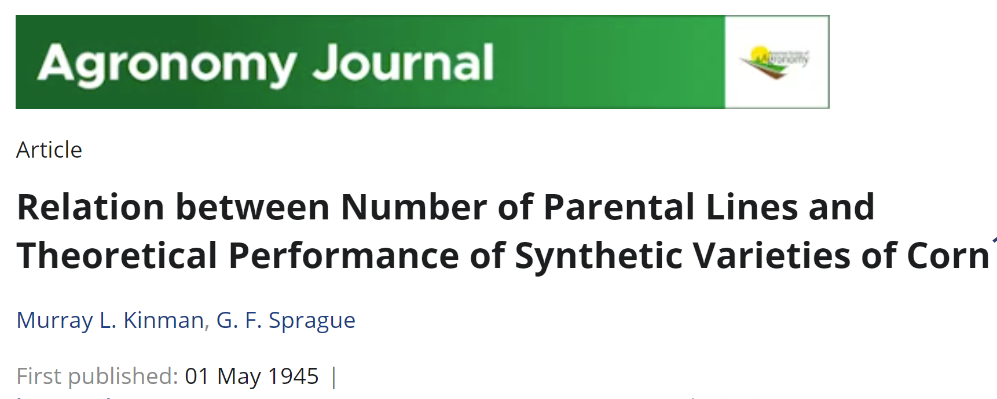
You note that the GCA values (General Combining Ability; Allgemeine Kombinationsfähigkeit) are the deviations from the General Mean. For instance, 50.089 - 47.222 gives the GCA effect of line 1 (GCA₁= -3.225 q/ha). Well. Not exactly so. The raw GCA is adjusted by 8/9 for a reason that you may find out yourself.
That adjustment does not change the rank position of the 10 GCA effects: Line 5 has the highest and line 10 the lowest GCA effect.
Each µ value such as 47.222 is the mean of nine crosses (off-spring) per inbred line. Ignore the 10th value ( the diagonal: a nuisance; brings pears in a comparison among apples). Each of the 10 µ values is the mean of the offspring from mating one of the 10 inbreds with ‘all’ others. Each such group-of-offspring is a family of half-sibs: The hybrids F1(1x2) ... F1(1x10) have a common mother (line 1) and private fathers: A nice half-sib family.
GCA effects are the Main Effects of the inbred lines. Linear model: Y_{ij} = µ + GCA_{i} + GCA_{j} + SCA_{ij} (SCA: Specific Combining Ability, Spezifische Kombinationsfähgikeit; interaction between genes of inbred lines i and j in their F1).
Mind that GCA data are more precise than SCA data, since the former usually come from (N-1=) 9-fold as many field plots compared to the latter. DOI 10.1007/BF00274716.
19

Slide 20
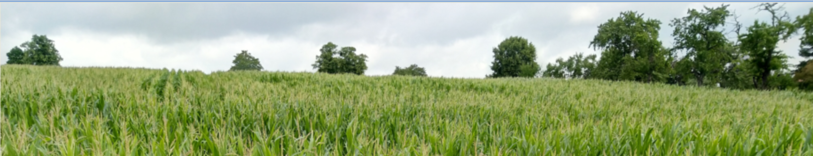
There is large variation for the interaction effects between the two parents, from -12.889 up to 12.736. The reciprocal data given here are not original but just via copy-paste ;-)
The 45 SCA-effects vary more than the 10 GCA effects seen before. The SCA-effects sum up to zero ‘already’ per row and per column. This is due to the way of estimating them.
GCA effects are main effects, to ‚predict‘ & ‚understand‘, whereas SCA effects as inter-actions are usually ‚non-understood‘. Hence, large SCA variance is oftentimes considered as undesired.
© WL
20

Slide 21
There is large variation for the interaction effects between the two parents, from -12.889 up to 12.736. The reciprocal data are not original but just via copy-paste ;-)
The 45 SCA-effects vary more than the 10 GCA effects seen before. The SCA-effects sum up to zero ‘already’ per row and per column. This is due to the way of estimating them.
GCA effects are main effects, to ‚predict‘ & ‚understand‘, whereas SCA effects as inter-actions are usually ‚non-understood‘. Hence, large SCA variance is oftentimes considered as undesired.
What is neglected here are genetic reasons for Reciprocal Differences: Differences between e.g. F1(1x2) with line 1 as mother and F1(2x1) with line 2 as mother. Such differences may be caused by so-called maternal effects (the mother type may produce ‚better‘ seed, may give its offspring a head-start) and/or by cytoplasmic effects (as orga-nelles and their DNA are mostly inherited maternally, it may make a difference whether offspring got mitochondria and chloroplasts from line 1 or 2). DOI 10.1007/BF00266997. Obviously, further phenomena such as epigenetics, including imprinting, … are neglected, too. DOI 10.1016/j.pbi.2017.01.005.
21

Slide 22
Apply: Compare the predictions-of-F1-hybrids .. based on GCA .. with ‘observed’ values
70
Take the GCA effects of the parental inbred lines 1 and 2:
GCA1 = -3.225; GCA2 = 0.400.
Hence, their hybrid F1(1x2) is predicted accordingly as
F1(1x2) = ? = µ + GCA1 + GCA2
F1(1x2) = 50.089 + (-3.225) + (0.400) = 47.264
47.264 q/ha is indeed not quite identical to the reported yield which was 51.00 q/ha (see again page 18).
The difference is 3.736 q/ha. This then is the estimate of SCA for that cross (for that pair of parents; for that pair of gametes; we neglect ‘error’ for sake of simplicity).
The diagram shows inasmuch the GCA effects alone allow to predict the hybrids. This is of high practical relevance, because GCA data can be produced much cheaper than SCA data (cf. Diallel, Factorial, Topcross, Polycross; these are rather Breeding Method topics).
65
60
r=0.77**
b=0.43
55
50
F1_{ij} = µ + GCA_{i} + GCA_{j} + SCA_{ij}
Realized performance of hybrids
45
40
35
30
F1_{ij} = µ + GCA_{i} + GCA_{j}
25
25
30
35
40
45
50
55
60
65
70
GCA-predicted performance of hybrids
22
Obviously, here the observed F1 performances came from those very environments from which the GCA data came, too. This is for sure naïve, because honestly we want to predict the F1’s performances in the Target Area of Marketing (at different site and future seasons). So, we have the topic of ... “what is the h² of GCA effects compared to h² of SCA effects” ? DOI 10.1007/BF00274716.

Slide 23
Equivalency & differences between (1) how we deduced the average effects of alleles & their dominance deviations and (2) how we define General & Spec. Combining ability.
The lines inherit A1 and A2 with p(A1) and q(A2)
23
In both, we take either A1 or A2 and mate it to the population to compare its offspring with the populations‘ µ. Although we do not know which allele e.g. line 1 has: It is homozygous and inherits either A1 or A2. And whether we designate a specific allele (or a specific haplotype or a specific homozygote) as number 1 or 2 (or 3 ...) is anyway completely arbitrary anyway - the point is clear, right? α₁ is inherited by inbred line 1 … just because we ;-) say-so.

Slide 24
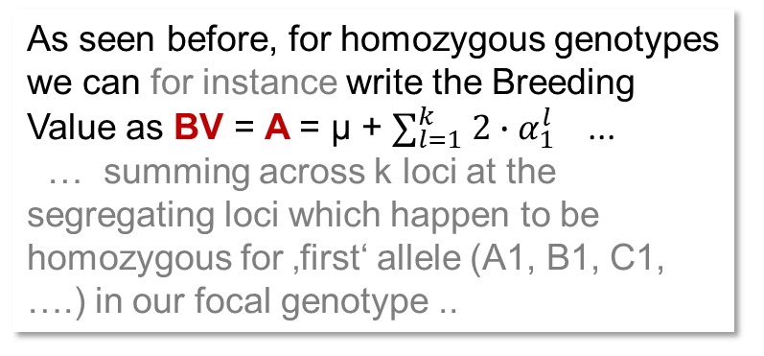
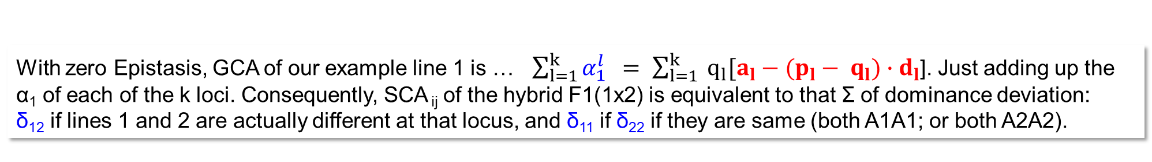
Equivalency & differences between (1) how we deduced the average effects of alleles and their dominance deviations and (2) how we define General & Specific Combining ability.
As seen before, for homozygous genotypes we can for instance write the Breeding Value as BV = A = µ + $∑_{l=1}^{k} 2∙α_{1}^{l}$ ...
… summing across k loci at the segregating loci which happen to be homozygous for ‚first‘ allele (A1, B1, C1, ….) in our focal genotype ..
We may not know which alleles actually are there in inbred line 1, we just name them A1, B1, C1 et cetera … for our teaching purpose here. With zero Epistasis, GCA of e.g. line 1 (-3.225 q/ha) is then the sum of the average additive effects of its alleles.
With zero Epistasis, GCA of our example line 1 is … $\sum_{l=1}^{k}{α_{1}^{l} } = \sum_{l=1}^{k}{{ q}_{l}[{a_{l}−(p}_{l}}− q_{l}){∙d}_{l}$]. Just adding up the α₁ of each of the k loci. Consequently, SCA _{ij} of the hybrid F1(1x2) is equivalent to that Σ of dominance deviation:
δ₁₂ if lines 1 and 2 are actually different at that locus, and δ₁₁ if δ₂₂ if they are same (both A1A1; or both A2A2).
24

Slide 25
See the equivalency and differences between (1) how we deduced the average effects of alleles and their dominance deviations and (2) how we define General and Specific Combining ability.
In the Quantitative Genetic (theoretical) approach, we take A1 gametes or A2 gametes. This is equivalent to take – in the practical (Diallel) approach – either A1A1-inbred lines or A2A2 inbred lines. Both of them produce only one type of gametes; this is the equivalence.
Of course, the theoretical approach is a monogenic view; view loci one by one; whereas the Diallel-based approach takes data of a trait such as grain yield: poly-genic. The latter is rather viewing on the sum of action of all those loci which jointly control the genetic variation of the trait. And - of course - this equivalence is only perfect if there was no epistasis.
The lines of our diallel cross represent the basic breeding pool and therefore, if they are nicely representative, they have and inherit A1 with p(A1) and A2 with q(A2). If p(A1)=0.2 in the basic pool, then 2 lines are A2A2 and the other 8 lines are A2A2. Like this at each locus.
Well, in an ideal world ;-)
25

Slide 26
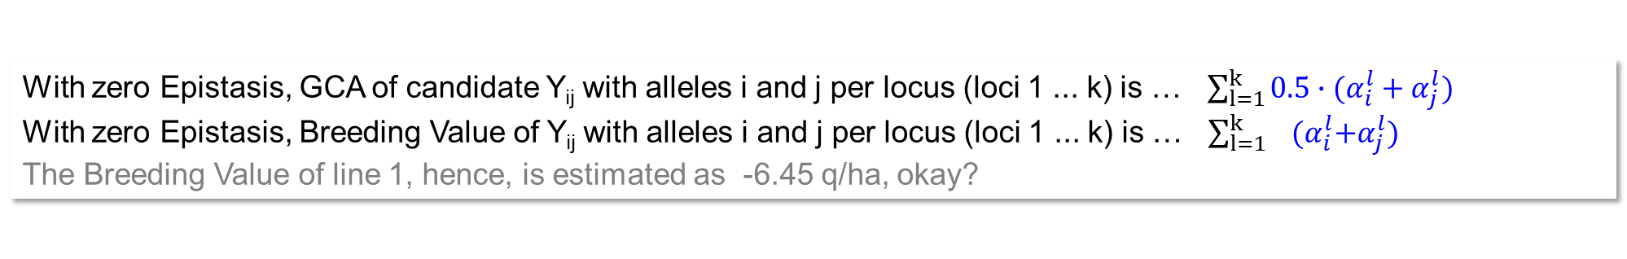
Assume zero epistasis and ponder GCA of the F1(1x2)
Assume zero epistasis and ponder Breeding Value of the F1(1x2)
With zero epistasis, the hybrid F1(1x2) ‚contains‘ and inherits the average GCA effect of its parental lines 1 and 2:
½ (-3.225 +0.400) = -1.4125 q/ha. This is its expected GCA if employed in this Diallel as parent number 11 (ignoring kinship issues).
The Breeding Value of that hybrid is twice its GCA, hence it is -2.825 q/ha.
GCA effects pertain to a gamete (or to the homozygous line that contributes such gamete – and contributes of course no other ones since homozygous=non-segregating).
Breeding Values pertain to a genotype.
With zero Epistasis, GCA of candidate Y_{ij} with alleles i and j per locus (loci 1 ... k) is … $\sum_{l=1}^{k}{{0.5∙(α}_{i}^{l}+α_{j}^{l}})$
With zero Epistasis, Breeding Value of Y_{ij} with alleles i and j per locus (loci 1 ... k) is … $\sum_{l=1}^{k}{{ (α}_{i}^{l}+α_{j}^{l}})$
The Breeding Value of line 1, hence, is estimated as -6.45 q/ha, okay?
26

Slide 27

With zero Epistasis,
GCA of candidate Y_{ij} with alleles i and j per locus (loci 1 ... k) is … $\sum_{l=1}^{k}{{0.5∙(α}_{i}^{l}+α_{j}^{l}})$
Look at it as the mean GCA of the two gametes that made this candidate.
With zero Epistasis,
Breeding Value of Y_{ij} with alleles i and j per locus (loci 1 ... k) is … $\sum_{l=1}^{k}{{ (α}_{i}^{l}+α_{j}^{l}})$
Look at it as the sum GCA of the two gametes that made this candidate.
If we ‘have’ Epistasis, then we can not avoid Epistasis to be included in GCA, since GCA is assessed at the trait level. The Breeding Value can (and is) nevertheless usually defined as the sum of the average effects of the alleles and hence excludes Epistasis even if exists.
Ponder yourself whether and how specific, fortunate epistatic effects as existing in parents can be exploited in breeding, for instance if you cross parents and risk to recombine sets of nicely co-evolved parental genes.
27

Slide 28
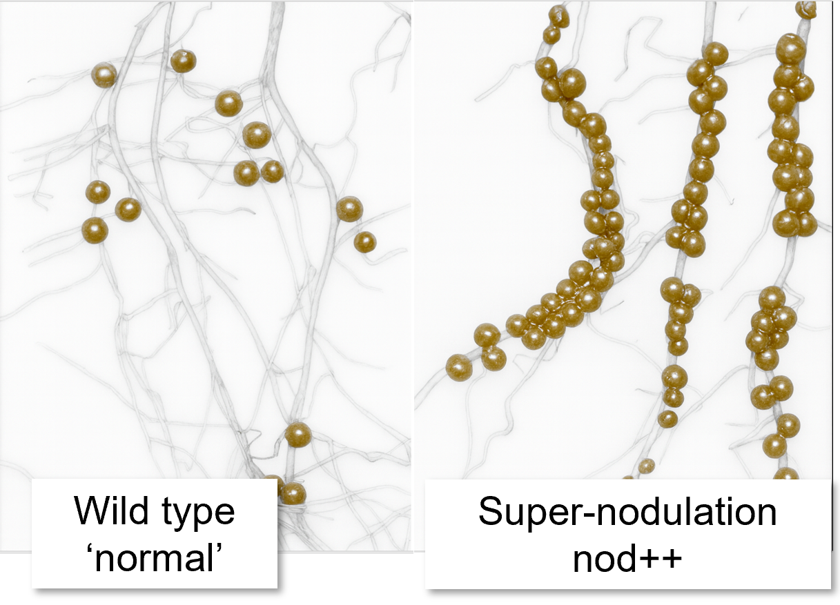
Exercise with two epistatic loci (nodulation in soybean). DOI 10.1007/BF00223798
Soybean genotype “Bragg” and mutants of it. Parent 1: aa/BB (“a” ► non-nodul.; locus “nts382”) Parent 2: AA/bb (“b” ► super-nod.; locus “nod772”)
Number of nodules per plant (+/- SE) depend on genotypes at these two loci. ‘Normal’ = ‘wild-type’: 150 nodules per plant
Locus B|b | Locus A|a
 | AA | Aa | aa
BB | 150 (10) | 150 (10) | 0
Bb | 150 (10) | 150 (10) | 0
bb | 370 (90) | 220 (20) | 20
Assume in the reference population p(A)=10% and p(B)=10% (loci unlinked). The metric additive effect for the A|a locus: a₁=125 nodules; for the B|b then a₂=-60 nodules. The metric dominance effects: d₁=50 and d₂=-60. This trait shows epistasis (visit UNPLAB-QuGen_Ch4[MetrMod])
Take these two candidate genotypes:
Cand. 1 = AA/bb; with a nodule number of 370;
Cand. 2 = aa/BB; with a nodule number of 0.
Ignoring Epistasis, population mean µ = 81.2 nodules.
Ignoring Epistasis, the Breeding Value of Cand. 1: A = 148.5 +10.8= 159.3
Ignoring Epistasis, the Breeding Value of Cand. 2: A = -16.5 -97.2 = -113.7
For this, you employ the Algebra shown earlier.
Including Epistasis, the Breeding Value of Cand. 1: A = 170.676
Including Epistasis, the Breeding Value of Cand. 2: A = -38.610
For this, you develop the offspring of Cand. 1 and of Cand. 2 when mated to this population. Inspect the difference of these two offspring generations to that initial population. Nota bene: Including Epistasis, µ = 53.61 nodules.
Here, the impact of Epistatic effects on the outcome is substantial.
28

Slide 29
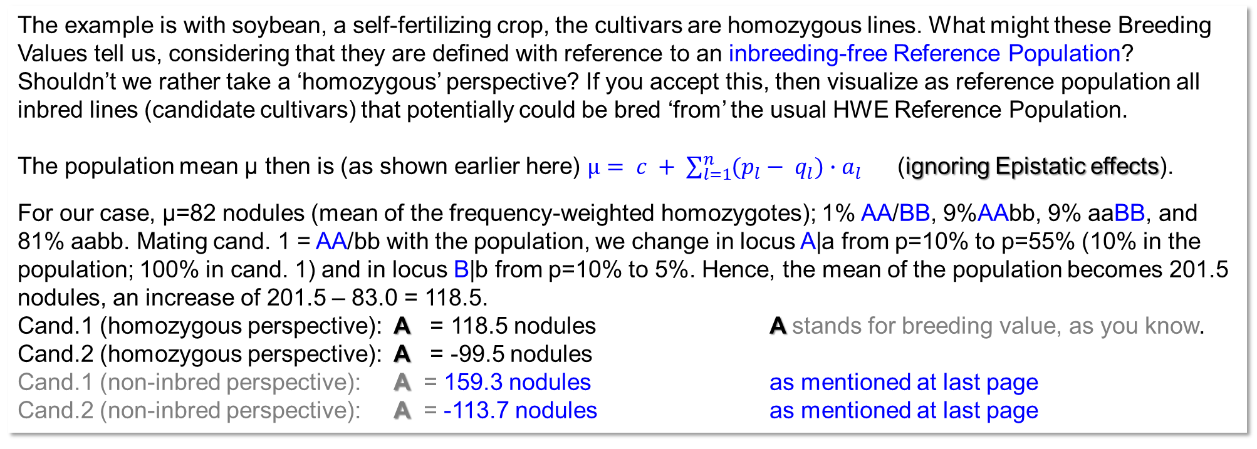
Exercise; Epistasis ignored (nodulation in soybean). DOI 10.1007/BF00223798
Number of nodules per plant. ‘Normal’ = ‘wild-type’: 150 |  |  |  | Number of nodules per plant given the additive effects as estimated yet zero epistasis
L2: B|b | Locus1: A|a |  |  | Locus 1: A/a
 | AA | Aa | aa | AA | Aa | aa
BB | 150 | 150 | 0 | 200 | 125 | -50
Bb | 150 | 150 | 0 | 200 | 125 | -50
bb | 370 | 220 | 20 | 320 | 245 | 70
The example is with soybean, a self-fertilizing crop, the cultivars are homozygous lines. What might these Breeding Values tell us, considering that they are defined with reference to an inbreeding-free Reference Population?
Shouldn’t we rather take a ‘homozygous’ perspective? If you accept this, then visualize as reference population all inbred lines (candidate cultivars) that potentially could be bred ‘from’ the usual HWE Reference Population.
The population mean µ then is (as shown earlier here) $µ= c + \sum_{l=1}^{n}{(p_{l}}− q_{l}){∙a}_{l}$ (ignoring Epistatic effects).
For our case, µ=82 nodules (mean of the frequency-weighted homozygotes); 1% AA/BB, 9%AAbb, 9% aaBB, and 81% aabb. Mating cand. 1 = AA/bb with the population, we change in locus A|a from p=10% to p=55% (10% in the population; 100% in cand. 1) and in locus B|b from p=10% to 5%. Hence, the mean of the population becomes 201.5 nodules, an increase of 201.5 – 83.0 = 118.5.
Cand.1 (homozygous perspective): A = 118.5 nodules A stands for breeding value, as you know.
Cand.2 (homozygous perspective): A = -99.5 nodules
Cand.1 (non-inbred perspective): A = 159.3 nodules as mentioned at last page
Cand.2 (non-inbred perspective): A = -113.7 nodules as mentioned at last page
29

Slide 30
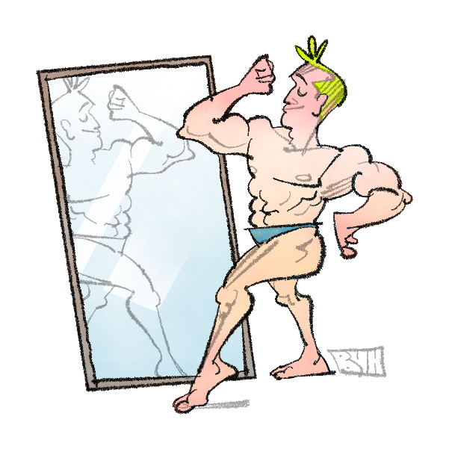
Because we have already moved a step beyond the standard perspective of normal lectures, and if we continued in this vein, we would soon enter speculative territory... we will therefore wisely and prudently conclude this chapter and move on to the next.
From here you may go to UNPLAB-QuGen_Ch-8[Decomp-GenV I]]
G = A + D
30
© Drawn by Henri Laugel
30

